Slide 1
Arizona Independent Redistricting Commission
Racially Polarized Voting Analysis
11/29/2011
1

Slide 4
Sample precinct:
40% of the electorate is Hispanic
60% of the electorate is non-Hispanic
Hispanic candidate “A” got 35% of the vote
What % of the Hispanic vote did candidate “A” receive?
4

Slide 5
Hispanic Support for Candidate A | Non-Hispanic Support for Candidate A | Hispanic Votes for Candidate A | Hispanic Votes for Candidate B | Non-Hispanic Votes for Candidate A | Non-Hispanic Votes for Candidate B | Total Votes for Candidate A | Total Votes for Candidate B | % for Candidate A
5% | 55% | 200 | 3,800 | 3,300 | 2,700 | 3,500 | 6,500 | 35%
10% | 52% | 400 | 3,600 | 3,120 | 2,880 | 3,520 | 6,480 | 35%
15% | 49% | 600 | 3,400 | 2,940 | 3,060 | 3,540 | 6,460 | 35%
20% | 45% | 800 | 3,200 | 2,700 | 3,300 | 3,500 | 6,500 | 35%
25% | 41% | 1,000 | 3,000 | 2,460 | 3,540 | 3,460 | 6,540 | 35%
30% | 38% | 1,200 | 2,800 | 2,280 | 3,720 | 3,480 | 6,520 | 35%
35% | 35% | 1,400 | 2,600 | 2,100 | 3,900 | 3,500 | 6,500 | 35%
40% | 31% | 1,600 | 2,400 | 1,860 | 4,140 | 3,460 | 6,540 | 35%
45% | 28% | 1,800 | 2,200 | 1,680 | 4,320 | 3,480 | 6,520 | 35%
50% | 25% | 2,000 | 2,000 | 1,500 | 4,500 | 3,500 | 6,500 | 35%
55% | 21% | 2,200 | 1,800 | 1,260 | 4,740 | 3,460 | 6,540 | 35%
60% | 18% | 2,400 | 1,600 | 1,080 | 4,920 | 3,480 | 6,520 | 35%
65% | 15% | 2,600 | 1,400 | 900 | 5,100 | 3,500 | 6,500 | 35%
70% | 11% | 2,800 | 1,200 | 660 | 5,340 | 3,460 | 6,540 | 35%
75% | 8% | 3,000 | 1,000 | 480 | 5,520 | 3,480 | 6,520 | 35%
80% | 5% | 3,200 | 800 | 300 | 5,700 | 3,500 | 6,500 | 35%
85% | 1% | 3,400 | 600 | 60 | 5,940 | 3,460 | 6,540 | 35%
90% | 0% | 3,600 | 400 | 0 | 6,000 | 3,600 | 6,400
95% | 0% | 3,800 | 200 | 0 | 6,000 | 3,800 | 6,200
100% | 0% | 4,000 | 0 | 0 | 6,000 | 4,000 | 6,000
5

Slide 6
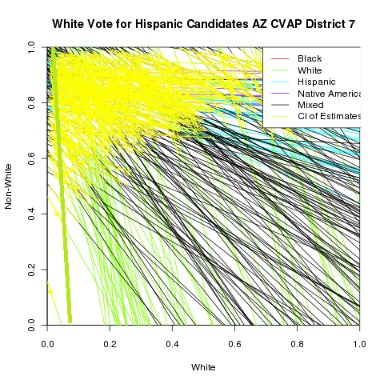
6

Slide 7
US House of Representatives 2010: District 7
7

Slide 8
Racially Polarized Voting Analysis
Existing Congressional Districts
Draft Congressional Districts
Existing Legislative Districts
Draft Legislative Districts
8

